Slide 1
PIRAI INFO TECH
Project demo presentation

Slide 2
Problem Statement & Assignment:
1. Create application login page using JavaFx.
2. We should be able to authenticate to the application using backend database(MySql, Oracle, MSSql).
3. Once the login is successful, there should be a page with 2 tabs. First tab should allow the user to enter the personal details (First Name, Last Name, Mobile Number, Address, City, State, Country) and the second tab should display the updated user details in grid format.4. If the authentication is not successful, Print a meaningful error message.

Slide 3
Tools / Frameworks to be used:
1. Front-end – JavaFx
2. Back-end – Spring

Slide 4
Overview
A simple, but at the same time powerful secure login and signup system, which mixes a lot of microservices together and make a unique choice to adopt it.
In addition, it comes along with the latest Spring framework Techonologies. Furthemore, this example is composed by a combination of Spring Boot 1.5.6,Spring Security, Mysql,Hibernate and JPA, Bootstrap 3 for the form design as well as jQuery for event handling.

Slide 5
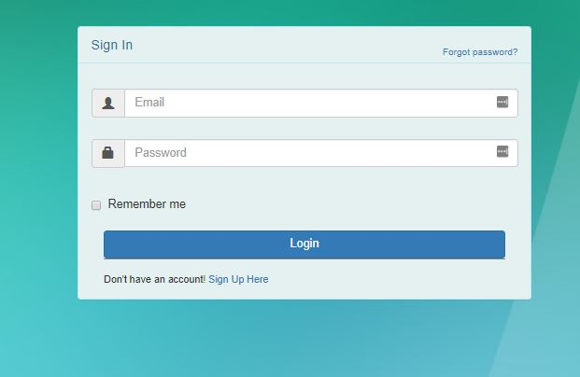
Login page

Slide 6
Basically, you declare your component and the relationship between them and the framework takes care of the lifecycle of your components and wires them together into a useful graph of objects.
If you consider how many libraries Spring integrates with, the competition fades away. A good way to convince yourself is to look at the number of guides or how-tos are available on the SpringWebsite
All of them follow one important pattern: specify the correct dependency, initialize a Spring component and autowire library beans into it.

Slide 7
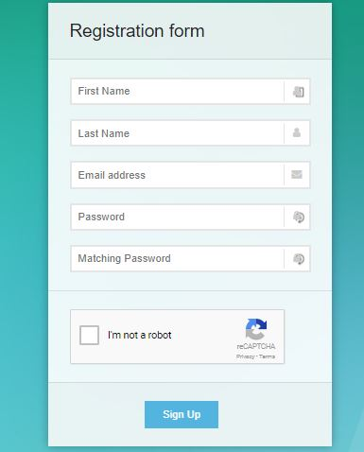
New registration page

Slide 8
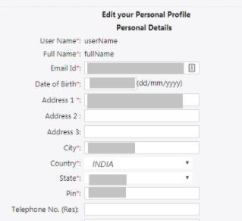
User details:

Slide 9
Deployment and Installtion
In order to deploy this projects, you need to perform some steps:
A favorite text editor or IDE
JDK 1.8 or later
Gradle 2.3
You can also import the code straight into your IDE:
Spring Tool Suite (STS)
Then Install MySQL

Slide 10
By following the below instruction
For testing purposes I use the UniformServer, a lightweight solution WAMP servr solution .So lets go to start. The Uniform Server Zeros base component is the controller application. Download and extract this base component first.
Download and save the latest controller file ZeroXI_Controller_latest_Version.exe to drive C:
The file is a self-extracting archive, double click to run the extractor.
The installation (extraction) defaults to creating folder C:\UniServerZ , with the folder structure as shown on the right.
The UniServerZ folder contains file UniController.exe which opens The Uniform Server's control application for running the servers as a standard program. simply run it.
Configure MySQL
In order to create, execute, and optimizing SQL queries for this project i am using MySQLWorkbench but you can also use whatever tool you want, as well as mysql command if you feel comfortable with it using the code

Slide 11
Basic functionality
SpringDataJPA
In order to start leveraging the Spring Data programming model with JPA, a DAO interface needs to extend the JPA specific Repository interface – JpaRepository. This will enable Spring Data to find this interface and automatically create an implementation for it.By extending the interface we get the most relevant CRUD methods for standard data access available in a standard DAO out of the box.
To define more specific access methods, Spring JPA supports quite a few options – you can:
simply define a new method in the interface.
provide the actual JPQ query by using the @Query annotation.
use the more advanced Specification and Querydsl support in Spring Data.
define custom queries via JPA Named Queries.
When Spring Data creates a new Repository implementation, it analyses all the methods defined by the interfaces and tries to automatically generate queries from the method names. While this has some limitations, it is a very powerful and elegant way of defining new custom access methods with very little effort.

Slide 12
Authentication Providers
An Authentication Provider is an abstraction for fetching user information from a specific repository (like a database, LDAP, custom third party source, etc. ).
It uses the fetched user information to validate the supplied credentials. Simply put, when multiple authentication providers are defined, the providers will be queried in the order they’re declared. For a quick demonstration, we’ll configure an in-memory authentication provider.

Slide 13
Spring Session has the simple goal of free up session management from the limitations of the HTTP session stored in the server. The solution makes it easy to share session data between services in the cloud without being tied to a single container
Additionally, it supports multiple sessions in the same browser and sending sessions in a header. Spring Session uses a filter, which accepts the Http Request and constructs and injects its own Request object down the hierarchy.
This way it gains control to the way new sessions are created, since the session object is attached to the Http Request Object.

